Slide 1
Recommendation Systems
Madhumathi Prakash & SonaLI Chaudhari

Slide 2
What is a recommendation System?
The ability for machines to predict things for users in a personal level.
Filters vital information according to user preferences
Useful for service providers as well:
Improve decision making process: : e-commerce setting- enhances revenues.

Slide 3
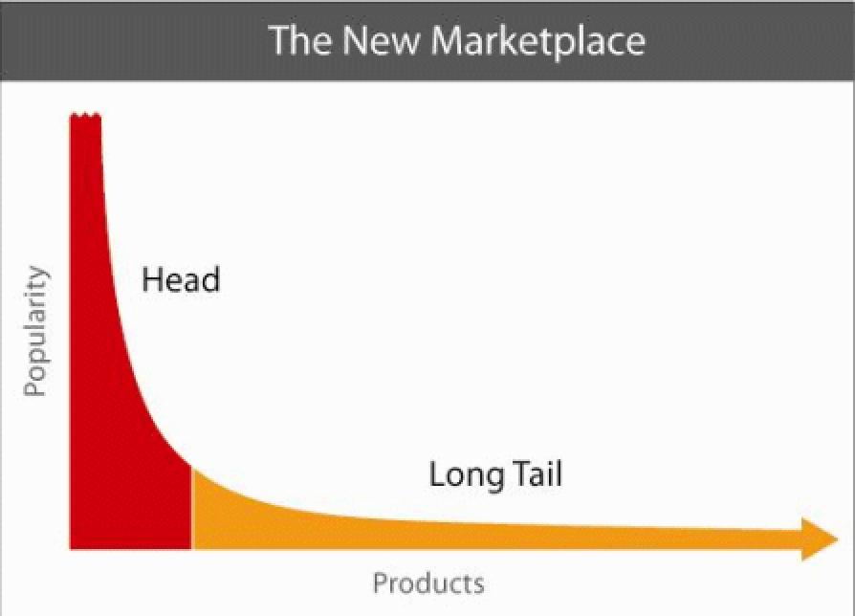
The Long Tail Effect
Physical delivery systems are characterized by a scarcity of resources.
On-line stores can make anything that exists available to the customer
Distinction between the physical and on-line worlds is known as the long tail phenomenon

Slide 4




Examples

Slide 5
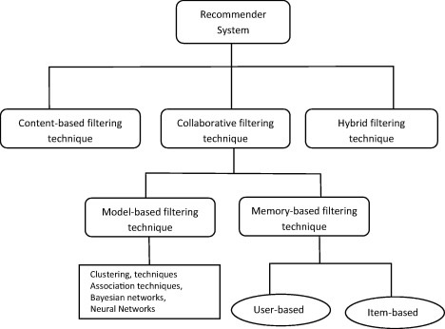
Overview of whole filtering

Slide 6
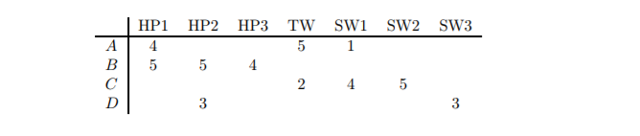
Utility Matrix
Users and items represented in a form of matrix
Example: user can rate movie 1-5 and blanks means users have not rated
HP is harry potter movies and SW is Star Wars
Recommender system predicts the blanks
Will account for properties of movies

Slide 7
Content based system
Idea is that if you like an item you will also like a similar item
It is based on similarity of items being recommended
Works well with movie or song recommendations: has properties for each item
For images uses and documents
Identify common words and compute the TF.IDF score for each word.
Higher the score = the more it describes the document
If other documents have TF.IDF score above certain threshold, then they are similar.

Slide 8
Collaborative Filtering
If person 1 likes A, B, C and person 2 likes B, C, D then they have similar interests so person 1 should like item D and person 2 will like A.
Algorithm is based on past.
Example: e-commerce like Amazon and American Express
Can have model based filtering techniques or memory based filtering techniques

Slide 9
Types of Memory based collaborative filtering
User-User filtering:
Finding alike customers based on similarity and suggest based on users past.
Effective but takes lot of time and effort
Item-Item filtering:
Similar but looks item and item look alike with matrix.
Recommends based on alike items to customers who purchased items in past.
Needs less resources than user-user.

Slide 10
DEMO

